Slide 1
2 Measures of location and spread pg. 5
Statistics

Slide 2

Statistics
Quick review
$$mean=\frac{\text{∑}\text{x}\text{​}}{n}$$
The median is the middle value of a data set when it is arranged in ascending or descending order. If there's an even number of data points, the median is the average of the two middle numbers.
{1, 3, 5, 7, 9, 11}
The mode is the most repeated value.
The range is obtained using maximum value – minimum value

Slide 3
Statistics
Quick review
the sum of all data values
$$mean=\frac{\text{∑}\text{x}\text{​}}{n}$$
the number of data values.
The median is the middle value of a data set when it is arranged in ascending or descending order. If there's an even number of data points, the median is the average of the two middle numbers.
{1, 3, 5, 7, 9, 11}
The mode is the most repeated value.
The range is obtained using maximum value – minimum value

Slide 4
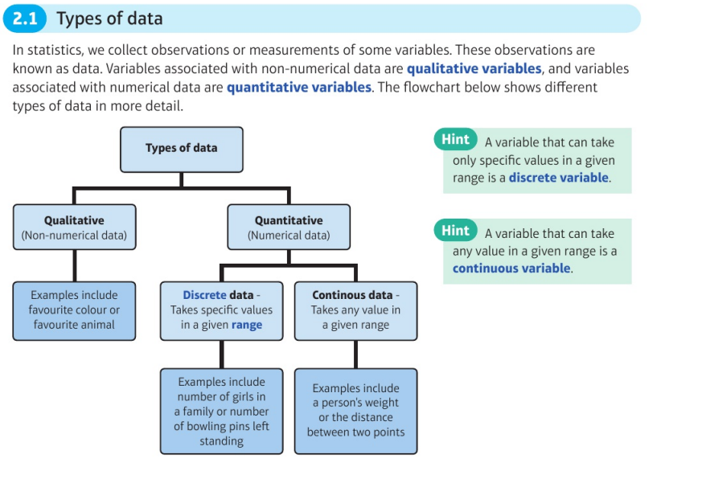
2 types of data
Statistics

Slide 5
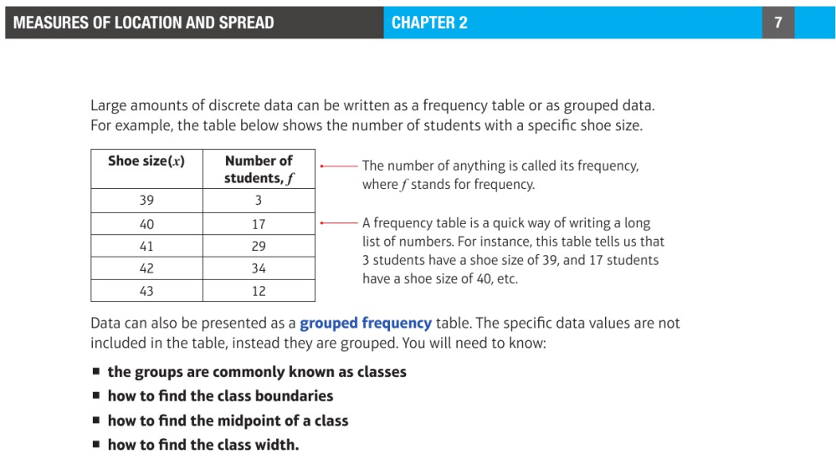
Statistics
Class Boundaries: These are the values halfway between the upper limit of one class and the lower limit of the next class.
>> Page 7.
{39,39,39,40,40,40,40,40,40,40,40,40,40,40,40,40,40,40,40,40,41,…..}

Slide 6
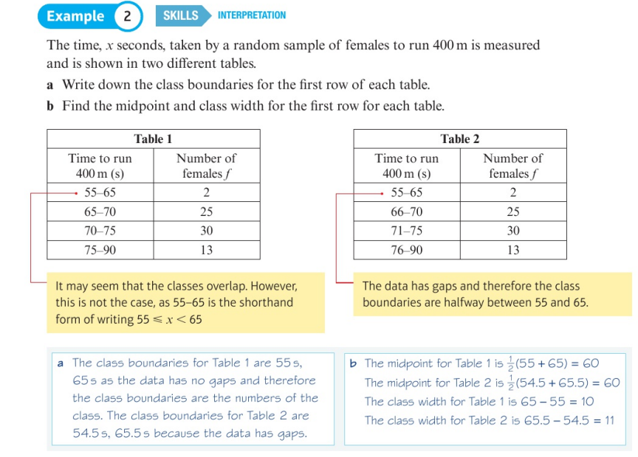
Statistics
Class Boundaries: These are the values halfway between the upper limit of one class and the lower limit of the next class.
Notes:
Classes are intervals in which data is grouped

Slide 7
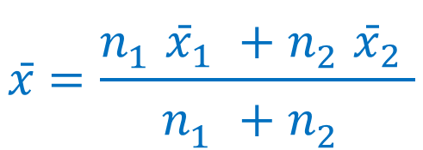
Statistics
Combining means
$$x̄=\frac{n_{1}^{}{x̄}_{1}^{}+n_{2}^{}{x̄}_{2}^{}\text{​}}{n_{1}^{}+n_{2}^{}}$$
$x̄=\frac{\sum{xf}\text{​}}{\sum{f}}$ , wherein x = data values, f = frequency

Slide 8
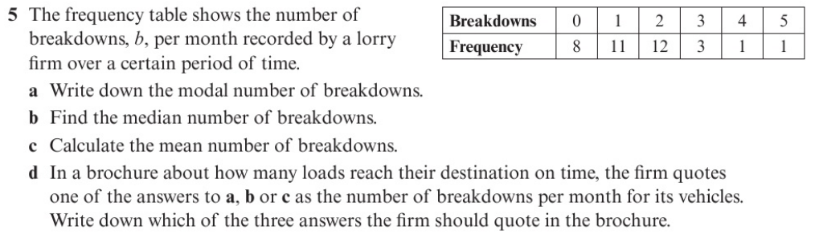
Statistics
Pg 11
Obtaining the median value from a frequency table: use cumulative frequency
Cumulative frequency is the sum of the previous frequencies

Slide 9

Statistics
Pg 11
Breakdowns | Frequency | Cumulative frequency
0 | 8 | 8
1 | 11 | 19
2 | 12 | 31
3 | 3 | 34
4 | 1 | 35
5 | 1 | 36
Median is in $\frac{36+1}{2}$ = 18.5 , which has a value of 1

Slide 10
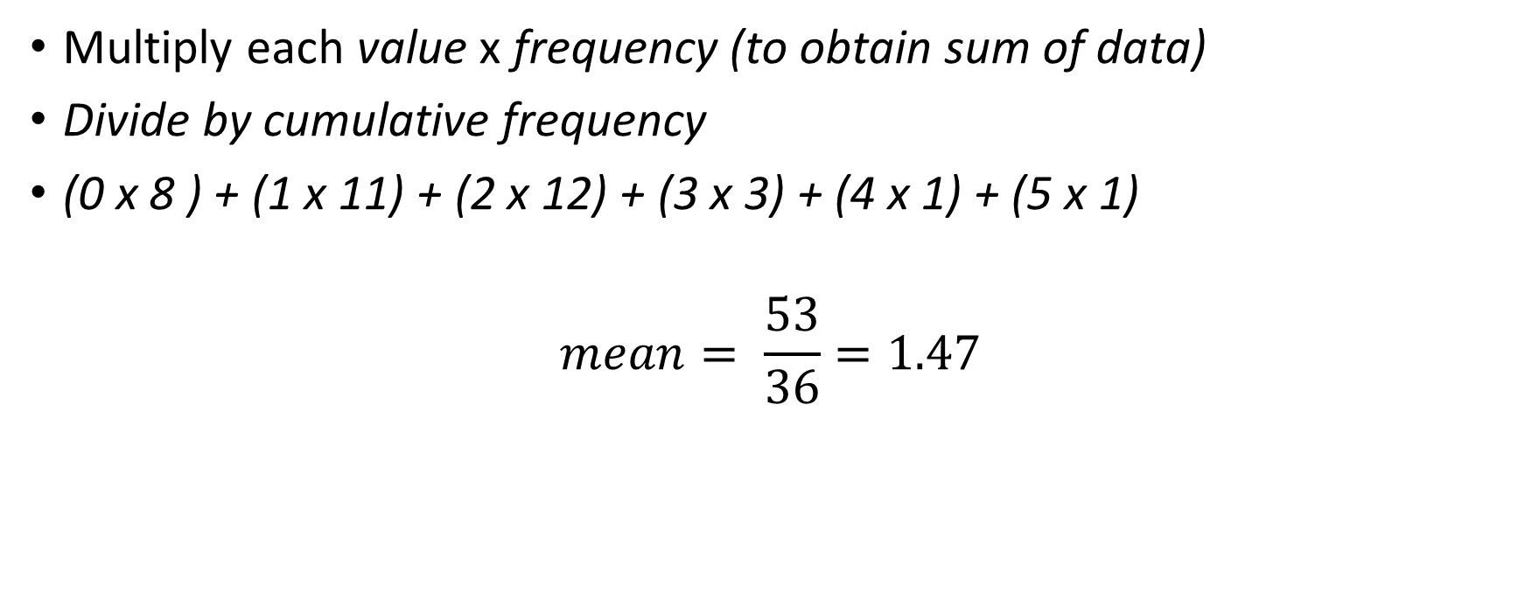
Statistics
Pg 11
Multiply each value x frequency (to obtain sum of data)
Divide by cumulative frequency
(0 x 8 ) + (1 x 11) + (2 x 12) + (3 x 3) + (4 x 1) + (5 x 1)
$$mean= \frac{53}{36}=1.47$$

Slide 11
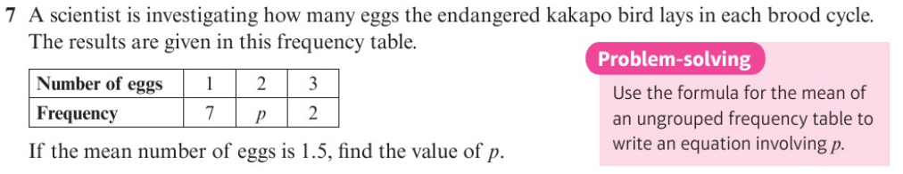

Statistics
Pg 11
$mean= \frac{Sum of values}{Total number of data }$.
(1 x 7) + (2 x p) + (3 x 2)
Cumulative frequency : 7 + p + 2 = 2 + p
$mean= \frac{1\left(7\right)+2\left(p\right)+3(2)}{9+p}$ ,
1.5 = $\frac{1\left(7\right)+2\left(p\right)+3(2)}{9+p}$
1.5(9+p) = 7 + 2p + 6
13.5 + 1.5p = 13 + 2p
(subtract 1.5p from both sides)
0.5p = 0.5
P= 1

Slide 12
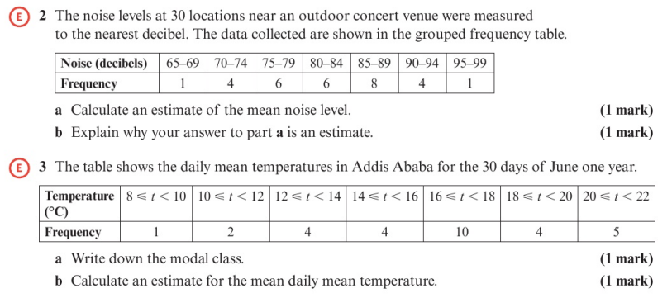
Statistics
Pg 12

Slide 13
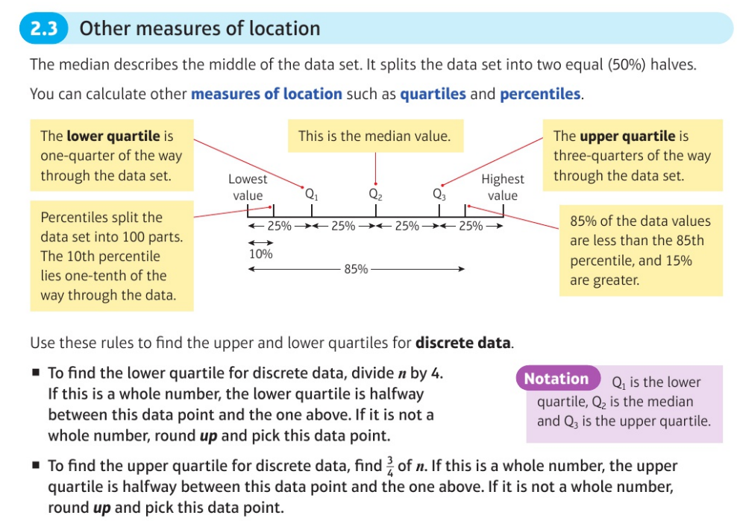
Statistics
Pg 16

Slide 14
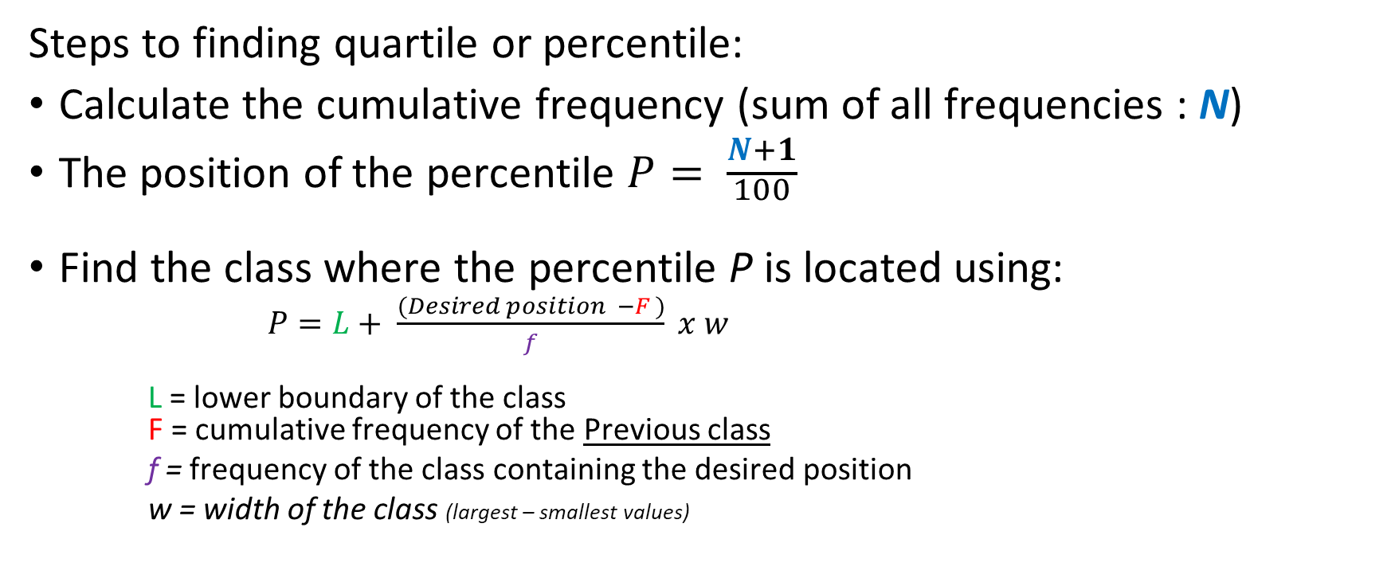
Statistics
Steps to finding quartile or percentile:
Calculate the cumulative frequency (sum of all frequencies : N)
The position of the percentile $P= \frac{N+1}{\begin{aligned}100 \\ \end{aligned}}$
Find the class where the percentile P is located using:
    $P=L+ \frac{(Desired position −F )}{f} x w$
    L = lower boundary of the class
    F = cumulative frequency of the Previous class
    f = frequency of the class containing the desired position
    w = width of the class (largest – smallest values)

Slide 15
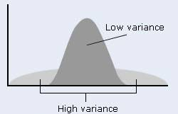

Variance and standard deviation
Statistics
$σ^{2}= \frac{\sum{(xi −μ)²}}{N}$ = $\frac{\sum{x²}}{N}$ - $(\frac{\sum{x}}{N})²$
$σ^{2}$ = population variance
$xi$ = each datapoint
$μ$ = the mean
N = the number of values in the dataset
Notes:
Variance is used to measure how spread the data is, usually with data of high variance, we get very low reliability.
Variance is known is the average distance between the mean and the dataset squared.
Variance is mean of the squared distances from the mean

Slide 16
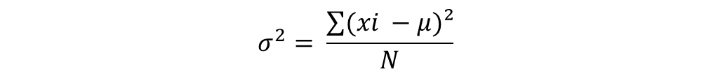
Variance and standard deviation
Statistics
Example: Calculate the variance for
Mr. Ahmed’s class grades: 82, 85, 78, 68
Ans)
1.
Ewe first need to find the mean
$$σ^{2}= \frac{\sum{(xi −μ)²}}{N}$$
$μ$ = $\frac{82+85+78+68}{4}$ =
Notes:
Variance is used to measure how spread the data is, usually with data of high variance, we get very low reliability.
Variance is known is the average distance between the mean and the dataset squared.
Variance is mean of the squared distances from the mean

Slide 17
Variance and standard deviation
Statistics
Example: Calculate the variance
Mr. Ahmed’s class grades: 82, 85, 78, 68
Ans)
1.
Ewe first need to find the mean
$$σ^{2}= \frac{\sum{(xi −μ)²}}{N}$$
$μ$ = $\frac{82+85+78+68}{4}$ = 78.25
Notes:
Variance is used to measure how spread the data is, usually with data of high variance, we get very low reliability.
Variance is known is the average distance between the mean and the dataset squared.
Variance is mean of the squared distances from the mean

Slide 18
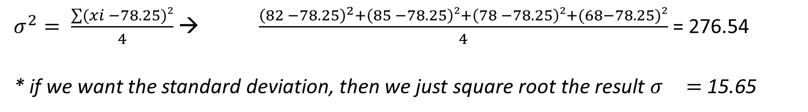
Variance and standard deviation
Statistics
Example: Calculate the variance
Mr. Ahmed’s class grades: 82, 85, 78, 68
Ans)
1.
$$σ^{2}= \frac{\sum{(xi −μ)²}}{N}$$
Ewe first need to find the mean
$μ$ = $\frac{82+85+78+68}{4}$ = 78.25
$σ^{2}= \frac{\sum{(xi −78.25)²}}{4}$ → $\frac{{\left(82 −78.25\right)}^{2}+\left(85 −78.25\right)²+\left(78 −78.25\right)²+(68−78.25)²}{4}$ = 276.54
* if we want the standard deviation, then we just square root the result $σ^{}=$15.65
Notes:
Variance is used to measure how spread the data is, usually with data of high variance, we get very low reliability.
High value of the variance means we have data varying a lot from our mean , low variance = data not varying from our mean.
Variance is known is the average distance between the mean and the dataset squared.
Variance is mean of the squared distances from the mean

Slide 19
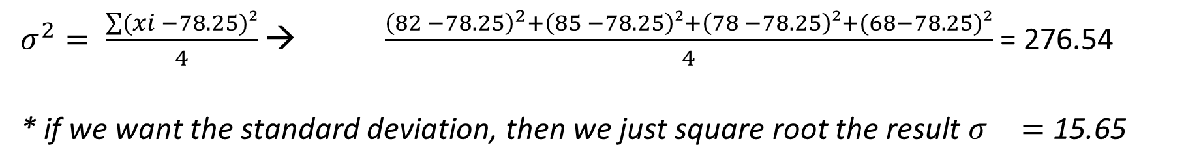
Variance and standard deviation
Statistics
Example: Calculate the variance
Mr. Ahmed’s class grades: 82, 85, 78, 68
Ans)
1.
$$σ^{2}= \frac{\sum{(xi −μ)²}}{N}$$
Ewe first need to find the mean
$μ$ = $\frac{82+85+78+68}{4}$ = 78.25
$σ^{2}= \frac{\sum{(xi −78.25)²}}{4}$ → $\frac{{\left(82 −78.25\right)}^{2}+\left(85 −78.25\right)²+\left(78 −78.25\right)²+(68−78.25)²}{4}$ = 276.54
* if we want the standard deviation, then we just square root the result $σ^{}=$15.65
Notes:
Variance is used to measure how spread the data is, usually with data of high variance, we get very low reliability.
High value of the variance means we have data varying a lot from our mean , low variance = data not varying from our mean.
Variance is known is the average distance between the mean and the dataset squared.
Variance is mean of the squared distances from the mean

Slide 20
Statistics
Coding allows statisticians to simplify complex rules or data into a format that is easier to analyze and understand.
Example 1: we can simplify ‘ to convert the temperature from Celsius to Kelvin we have to add 273 to it’
we just apply coding y = x + 273
Example 2: we can simplify ‘ to convert the temperature from Celsius to F we multiply by 1.8 , then we add 32
We can just apply coding instead y = 1.8 x + 32

Slide 21

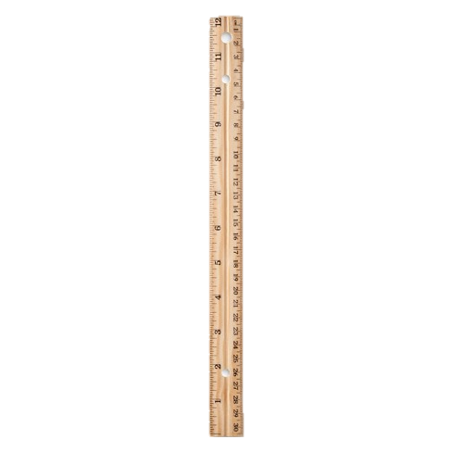
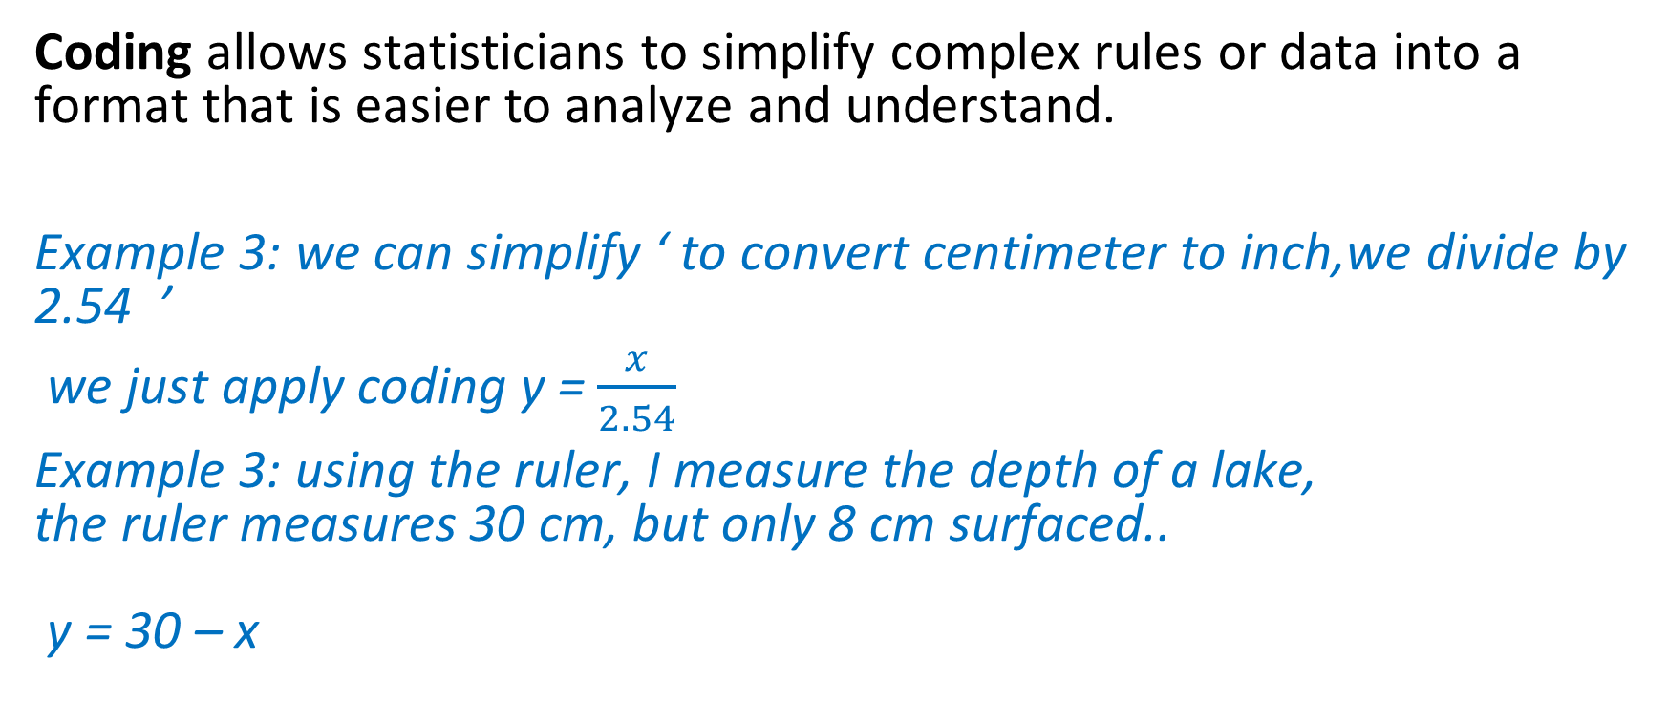
Statistics
Coding allows statisticians to simplify complex rules or data into a format that is easier to analyze and understand.
Example 3: we can simplify ‘ to convert centimeter to inch,we divide by
2.54 ’
we just apply coding y = $\frac{x}{2.54}$
Example 3: using the ruler, I measure the depth of a lake,
the ruler measures 30 cm, but only 8 cm surfaced..
y = 30 – x

Slide 22
Statistics
Coding allows statisticians to simplify complex rules or data into a format that is easier to analyze and understand.
Example 3: we can simplify ‘ to convert centimeter to inch,we divide by
2.54 ’
we just apply coding y = $\frac{x}{2.54}$
Example 3: using the ruler, I measure the depth of a lake,
the ruler measures 30 cm, but only 8 cm surfaced..
y = 30 – x
Visible measurement
depth

Slide 23
Statistics
Coding allows statisticians to simplify complex rules or data into a format that is easier to analyze and understand.
Example 3: we can simplify ‘ to convert centimeter to inch,we divide by
2.54 ’
we just apply coding y = $\frac{x}{2.54}$
Example 3: using the ruler, I measure the depth of a lake,
the ruler measures 30 cm, but only 8 cm surfaced..
y = 30 – x
Visible measurement
depth

Slide 24

Statistics
y = x + 273
y = $\frac{x}{2.54}$
Y = 30 – x
Y is the coded data
X is the original data

Slide 25
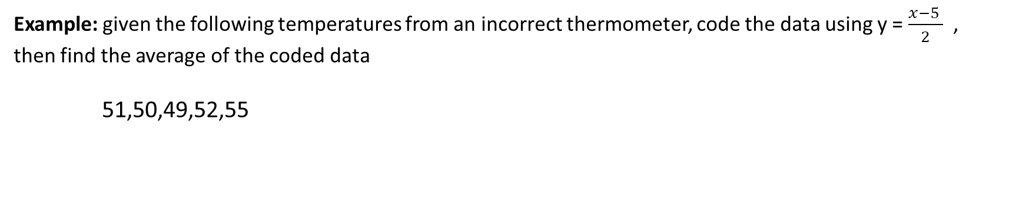

Statistics
y = $\frac{x−a}{b}$
$\overline{y}$= $\frac{\overline{x}−a}{b}$
constant
Coded value
Example: given the following temperatures from an incorrect thermometer, code the data using y = $\frac{x−5 }{2}$ , then find the average of the coded data
51,50,49,52,55

Slide 26
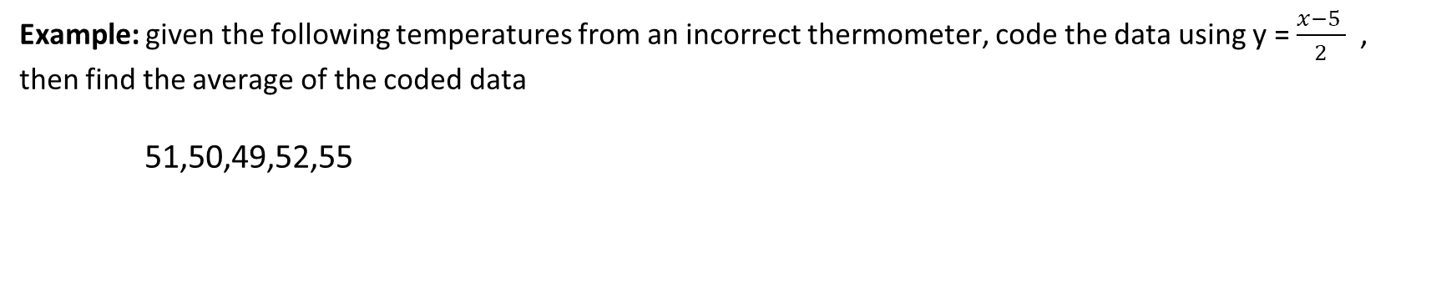
Statistics
y = $\frac{x−a}{b}$
$\overline{y}$= $\frac{\overline{x}−a}{b}$
constant
Coded value
Example: given the following temperatures from an incorrect thermometer, code the data using y = $\frac{x−5 }{2}$ , then find the average of the coded data
51,50,49,52,55

Slide 27
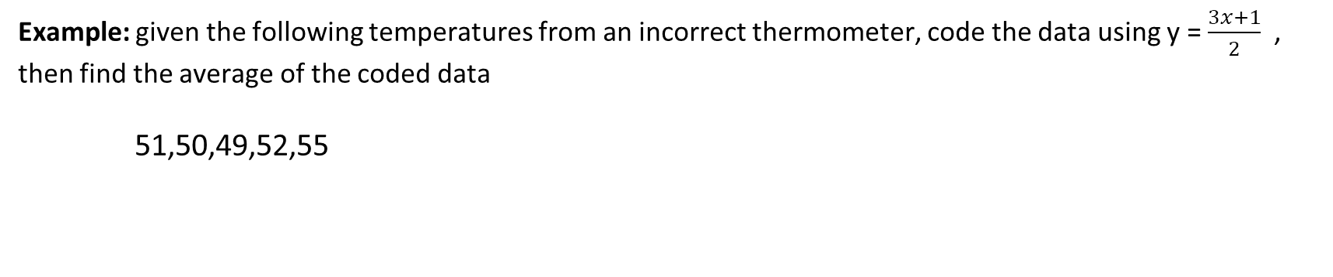
Statistics
y = $\frac{x−a}{b}$
$\overline{y}$= $\frac{\overline{x}−a}{b}$
constant
Coded value
Example: given the following temperatures from an incorrect thermometer, code the data using y = $\frac{3x+1}{2}$ , then find the average of the coded data
51,50,49,52,55
Notes:
If you code the data then average the result, you won’t get the same as averaging the data then coding the result of the original average.

Slide 28
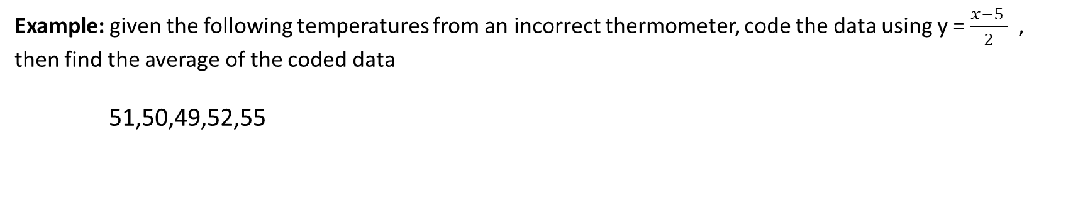
Statistics
y = $\frac{x−a}{b}$
$\overline{y}$= $\frac{\overline{x}−a}{b}$
constant
Coded value
Example: given the following temperatures from an incorrect thermometer, code the data using y = $\frac{x−5 }{2}$ , then find the average of the coded data
51,50,49,52,55

